Slide 1


Front End
Brittany Arthur
Cassandra Gordon
Jason Heron
Kevin Stewart
Rita Valentine

Slide 2
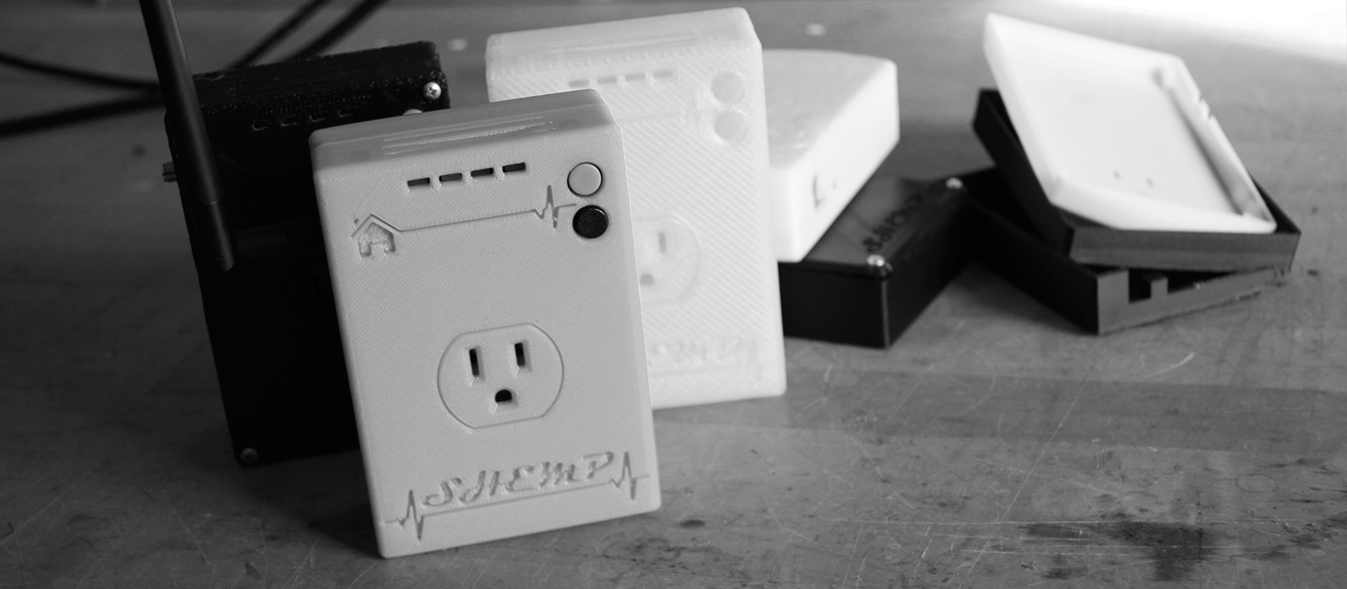
What is our Project?
SEADS: Software and hardware for:
monitoring, optimizing and
understanding energy usage.
Frontend: Create website for users to manage SEADS devices and visually monitor usage.
Notes:
EXPAND ON BOTH POINTS WHILE TALKING.

Slide 3
Goals Achieved vs Planned
✓ Transition from PHP → Django
✓ Add functionality (e.g Visualize Data)
✓ Integrate backend API
✓ Polish it real good
✕ Visualize real time data
✕ Differentiate appliances with images
Notes:
Talk about our goals. A sleek website with functionality - ability to register and manage devices INCLUDE THOUGHTS ABOUT VISUALIZATION AND HOPEFULLY THE ABILITY TO CLASSIFY APPLIANCES.

Slide 4
Challenges + Accomplishments
Learning Django → accomplished
Multi-Team Communication → brutal/challenge
Django site transition → accomplished
Getting the system to function → accomplished
Adding new features → accomplished

Slide 5

Technology
Version Control: Git / Github
Edit: SublimeText
Frameworks: Django, Bootstrap
Server: Gunicorn, Nginx, Ubuntu Server
Languages: Python, JavaScript
Magic: JQuery, Ajax, Moment.js, Google charts
Hardware: SEADS Plug

Slide 6

Things we….
Enjoyed
Learning Python/Django/Server+Client Application
Real Data with real API
External Sponsor
Didn’t Enjoy
Multiple/different time commitments
Work that didn’t directly apply to our project (?)
Lack of clarity in terms of expectations/timelines

Slide 7
Lessons Learned
Worked:
Version Control
Python (the one true god)
Inter-team/Intra-team communication (difficult but valuable lessons)
Broken:
Long meetings + wasted time
Burn-up Chart

